Slide 1
BOOTSTRAP TABLE
PRESENTED BY,
GNANAMANISWEETY. S

Slide 2
INTRODUCTION TO BOOTSTRAP
Bootstrap is a free and open-source framework that speeds up website development.
It is designed for mobile-first, ensuring websites work well on all screen sizes.
It uses a flexible 12-column grid system for easy page layout.
It offers ready-made elements like buttons, forms, and navigation bars.
Easily customizable with themes and styling options.

Slide 3
BOOTSTRAP TABLES
Bootstrap tables offer a clean, styled layout for displaying data in rows and columns.
They include basic styling for headers, rows, and borders, making tables look professional by default.
Tables are responsive, adjusting to fit different screen sizes with features like scrollable horizontal overflow.
Bootstrap supports table variants like striped rows, bordered tables, and hover effects to enhance readability.
Additional classes allow customization, such as aligning text, changing colors, and adding captions for clarity.

Slide 4
EXAMPLE PROGRAM
<!DOCTYPE html>
<html lang="en">
<head>
<meta charset="UTF-8">
<meta name="viewport" content="width=device-width, initial-scale=1.0">
<title>Bootstrap Basic Table</title>
<style>
tr,td,table,th{
border: 1px solid black;
padding: 10px;
text-align: center;
}
</style>
<link href="https://cdn.jsdelivr.net/npm/bootstrap@5.3.3/dist/css/bootstrap.min.css" rel="stylesheet" integrity="sha384-QWTKZyjpPEjISv5WaRU9OFeRpok6YctnYmDr5pNlyT2bRjXh0JMhjY6hW+ALEwIH" crossorigin="anonymous">
</head>

Slide 5
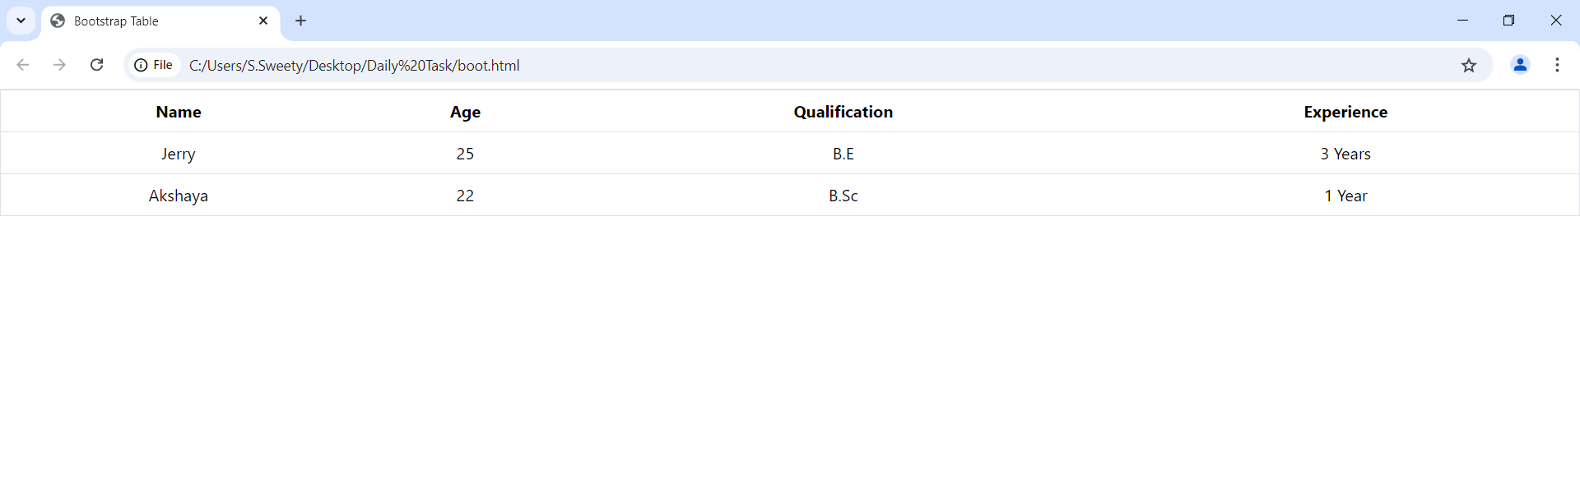
<body>
<table class=“table”>
<thead>
<tr>
<th>Name</th>
<th>Age</th>
<th>Qualification</th>
<th>Experience</th>
</tr> </thead>
<tbody>
<tr>
<td>Jerry</td>
<td>25</td>
<td>B.E</td>
<td>3 Years</td>
</tr> <tr>
<td>Akshaya</td>
<td>22</td>
<td>B.Sc</td>
<td>1 Year</td>
</tr>
</tbody>
</table>
<script src="https://cdn.jsdelivr.net/npm/bootstrap@5.3.3/dist/js/bootstrap.bundle.min.js" integrity="sha384-YvpcrYf0tY3lHB60NNkmXc5s9fDVZLESaAA55NDzOxhy9GkcIdslK1eN7N6jIeHz" crossorigin="anonymous"></script>
</body>
</html>
OUTPUT

Slide 6
TYPES OF STYLING OPTIONS
Striped Table
Bordered Table
Hoverable Table
Small Table
Dark Table
Contextual Table

Slide 7


STYLING OPTIONS
STRIPED TABLE
Striped table uses .table-striped to add alternating colors to improved readability.
BORDERED TABLE
Bordered table uses .table-bordered for border around each cell, giving a structured look.

Slide 8
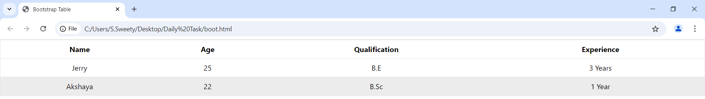
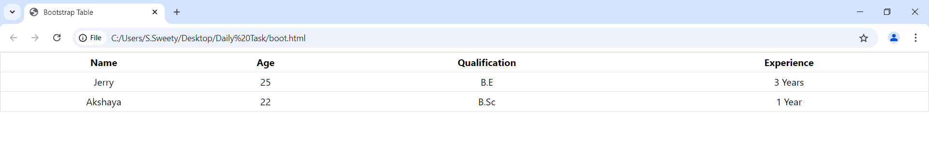
HOVERABLE TABLE
The Hoverable table uses .table-hover to highlight when hovered, making it easier to track data.
SMALL TABLE
The Small table uses the .table-sm class to create a compact table with less padding, which is ideal for a tighter layout.

Slide 9
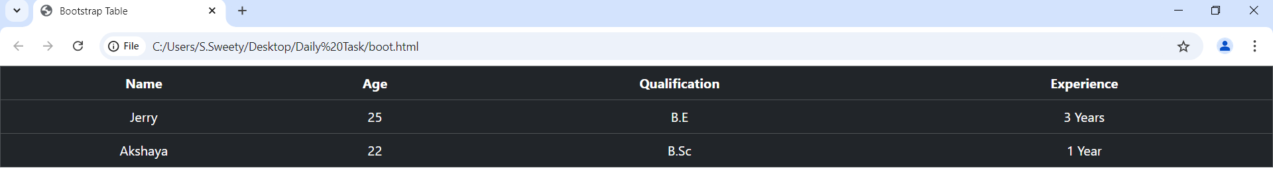
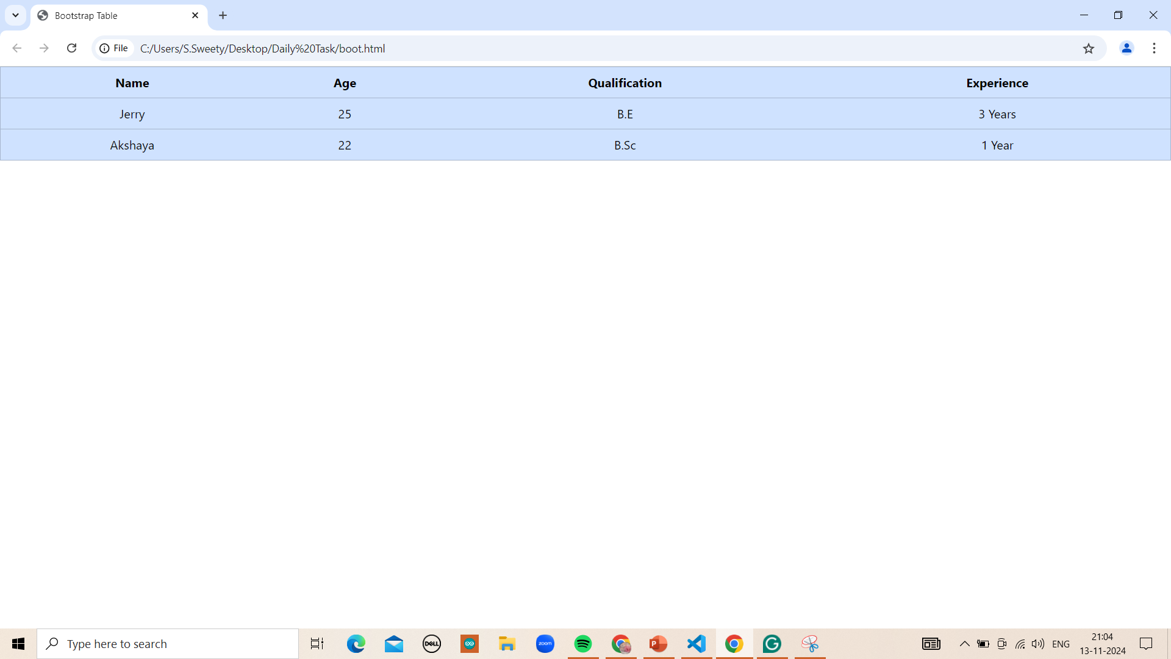
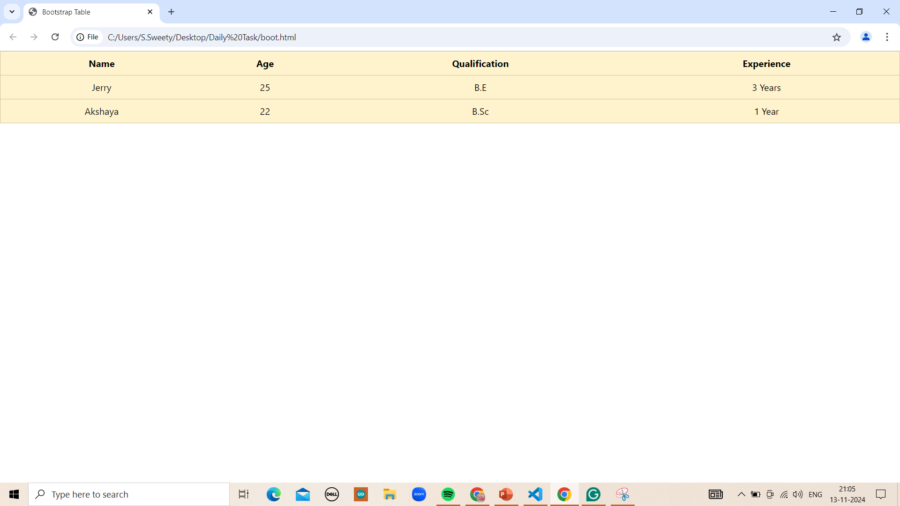
DARK TABLE
The dark table uses .table-dark for a dark background on the table, suitable for dark-themed designs.
CONTEXUAL TABLE
The Contextual table applies color-coded classes like .table-primary, .table-success, .table-warning, etc,. to rows or cells for visual emphasis on specific data.

Slide 10
RESPONSIVE TABLE
Responsive tables adjust to fit the screen size, ensuring data is readable on any device, from desktops to mobile phones.
Use the .table-responsive class to enable horizontal scrolling on smaller screens, preventing data from being cut off.
Responsive tables maintain a clean and readable layout, even on narrow screens, by removing the need for manual adjustments.

Slide 11
ADVANTAGE
Bootstrap tables provide built-in styling, making them look professional without needing custom CSS.
They are responsive by default, ensuring a smooth user experience on any device.
Customization is easy, with options for striped rows, borders, and hover effects using simple classes.

Slide 12


